Slide 1

Remote CARI (rCARI) Validation pilot Study
Preliminary Results from Burkina Faso
APP-FA | February 2025

Slide 2
Background – Burkina Faso
Burkina Faso, one of the pilot countries in RBD
Protracted conflict & instability has increased food insecurity prevalence in the population
Piloted remote data collection for CH & PDMs
Implemented in the general population
3 Regions in total
CH classification of 2024
Accessibility
Livelihood (urban & rural)
Notes:
rCARI useful in emergencies where F2F survey is not feasible
The Challenge with rCARI numbers & methodology is that not it is been validated against CARI or IPC
Though is easily available, results are not globally accepted
rCARI is based on the following modules
Food consumption score
Consumption-based coping strategy (rCSI)
Livelihood coping strategy (usually a shorter version of the original)
Income sources
Changes in income

Slide 3
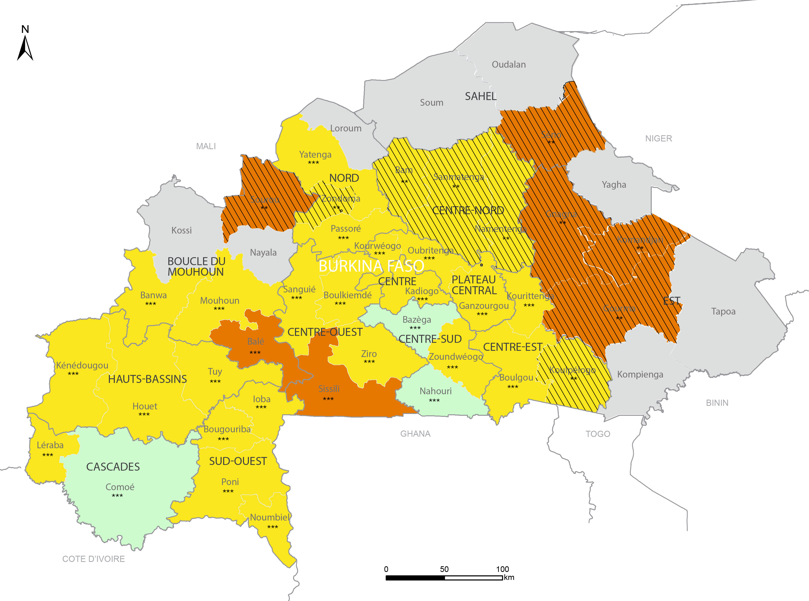
Background – Burkina Faso
Notes:
rCARI useful in emergencies where F2F survey is not feasible
The Challenge with rCARI numbers & methodology is that not it is been validated against CARI or IPC
Though is easily available, results are not globally accepted
rCARI is based on the following modules
Food consumption score
Consumption-based coping strategy (rCSI)
Livelihood coping strategy (usually a shorter version of the original)
Income sources
Changes in income

Slide 4
overall Research Objective
Validate and calibrate rCARI with the standard CARI methodology
Specific objectives:
Compare food security indicators collected remotely (FCS, rCSI, LCS, FES, income sources and income change) against the F2F modality

Slide 5
Overall sampling framework

Slide 6
Survey SETUP
Full CENSUS of HHs
10,456 HHs
4256 Sampled Households
Modality Assignment
1st Random Assignment
F2F modality
Remote modality
Long f2f modules
Long remote-modules
Module length
2nd Random Assignment
Short f2f Modules
Short remote Modules

Slide 7
Timelines of the pilot
Activity\Timeline | Aug 24 Week 2-3 | Aug 24 Week 4 | Sept 24 Week 1 | Sept 24 Week 2 | Sept 24 Week 2-4 | Oct-dec 2024
Household Census (ADMIN5s)
Enumerator training
Field Testing
Finalizing Tool
Field Survey/HFC
Data cleaning & Analysis

Slide 8
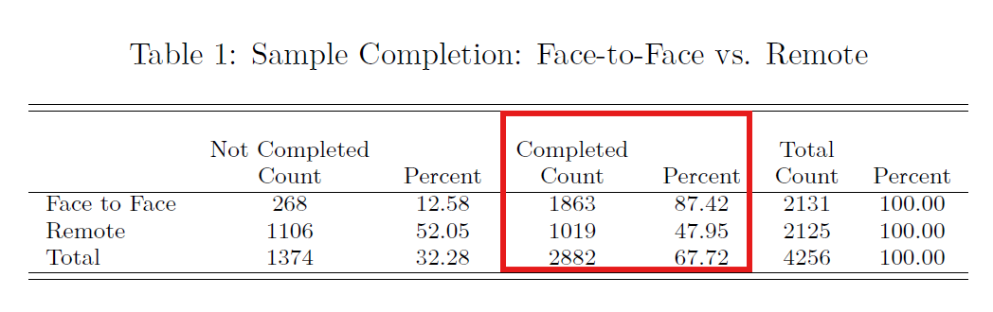
Sample Completion

Slide 9
Aggregation methods to be tested
 | Aggregation Methodology
Indicator | CARI | rCARI (FES) | rCARI (Income) | rCARI (F2F)
FCS | Yes | Yes | Yes | Yes
FES | Yes | Yes | No | No
LCS | Yes | Yes | Yes | Yes
rCSI | Yes | Yes | Yes | Yes
Income source & income change | No | No | Yes | Yes

Slide 10
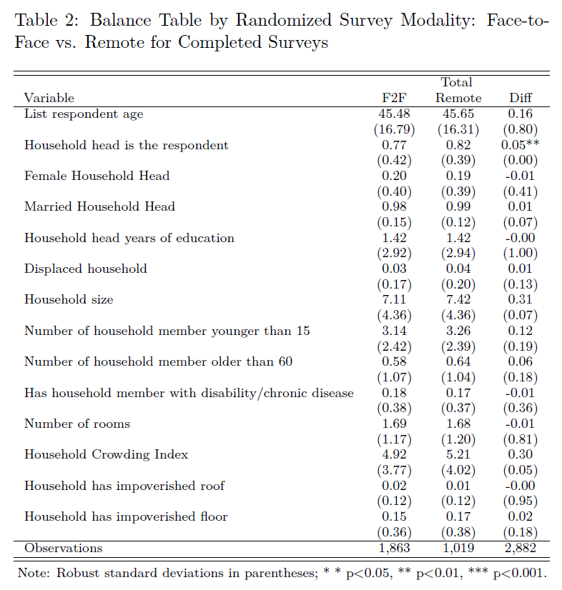
Balance tests for completed sample

Slide 11
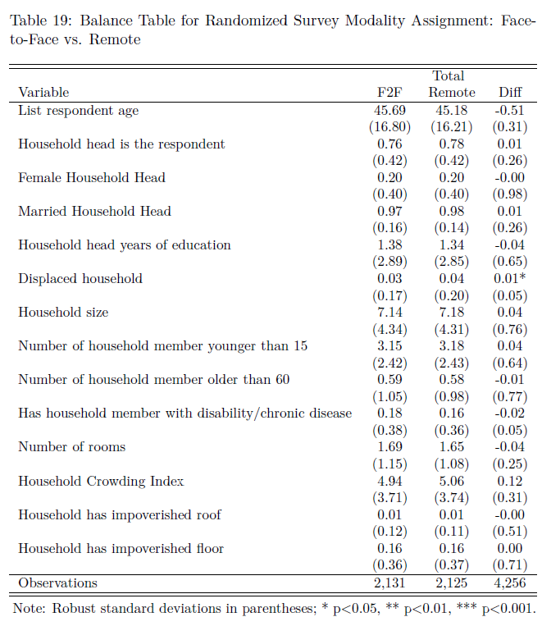
Balance tests for Full sample

Slide 12
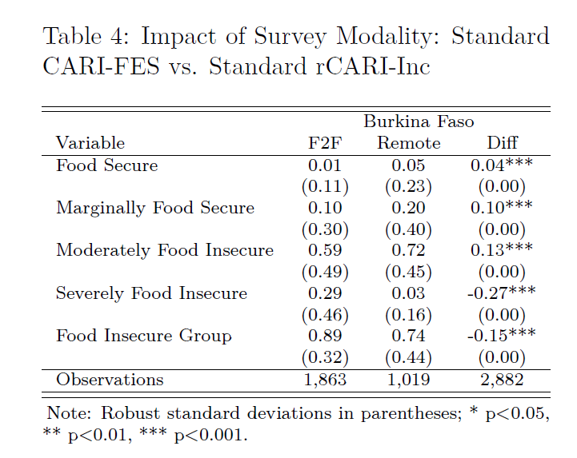
CARI vs. rCARI Disaggregation

Slide 13
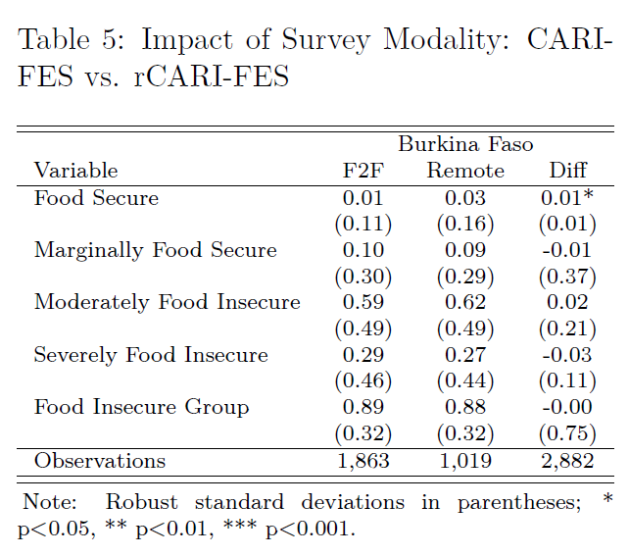
CARI vs. rCARI Disaggregation

Slide 14
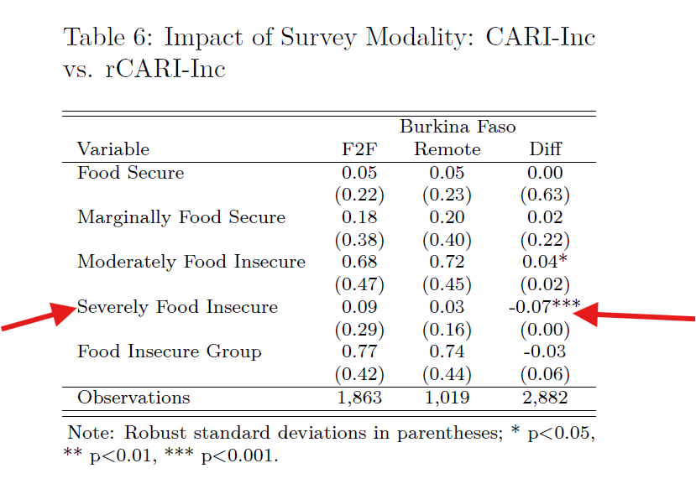
CARI vs. rCARI Disaggregation

Slide 15
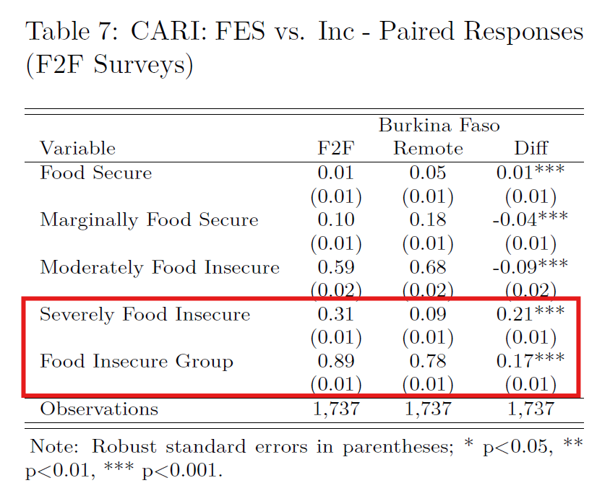
CARI vs. rCARI Disaggregation

Slide 16
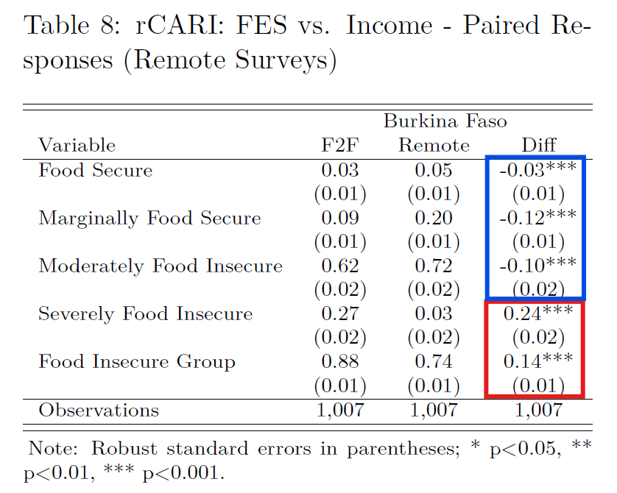
CARI vs. rCARI Disaggregation

Slide 17
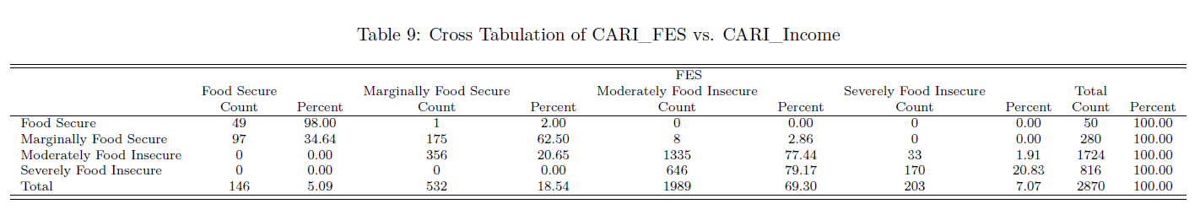
Sensitivity analysis of the 4-cari categories

Slide 18
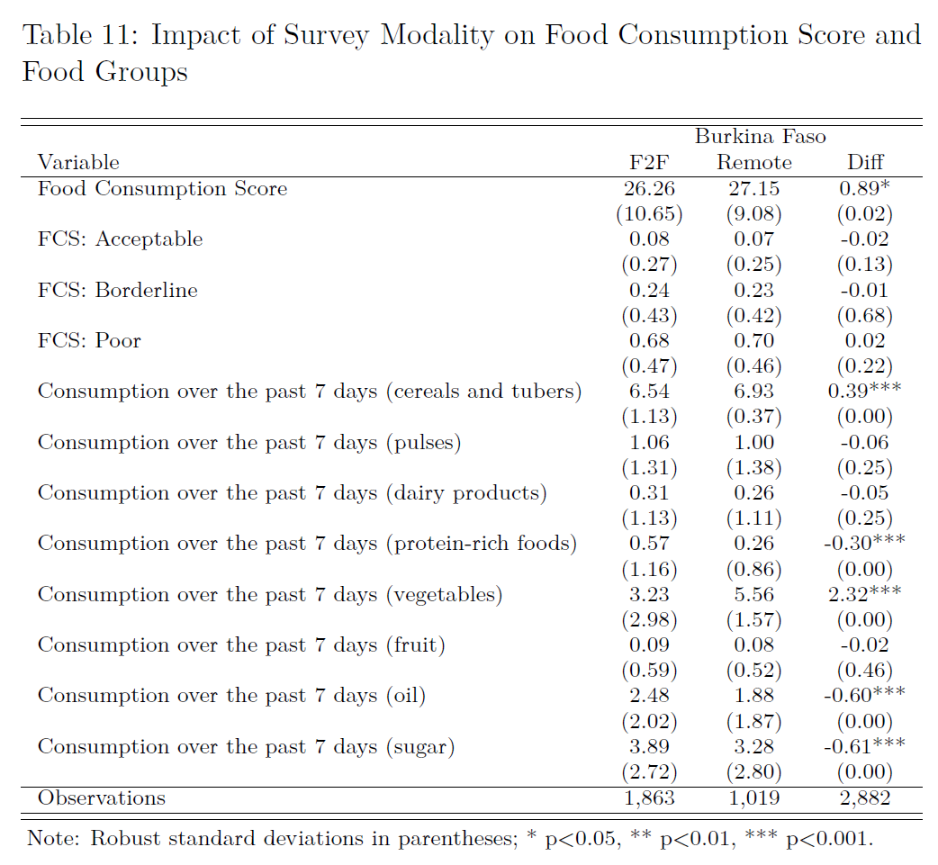
Other Food Security Outcome Indicators

Slide 19
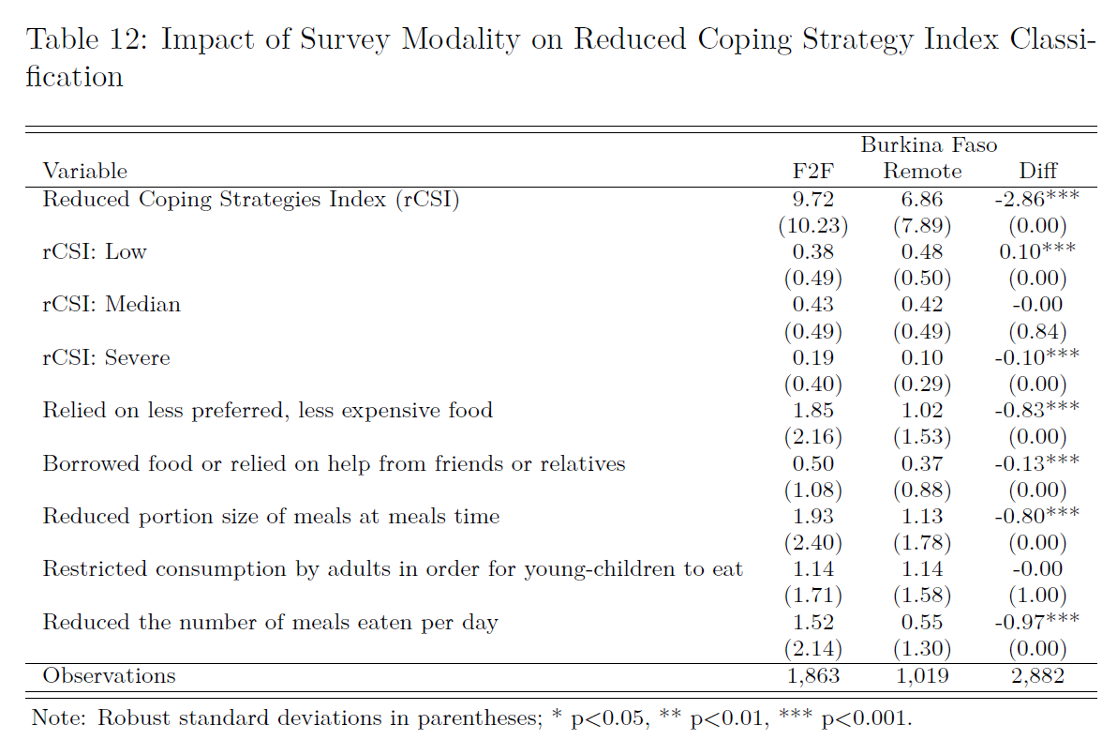
Other Food Security Outcome Indicators

Slide 20
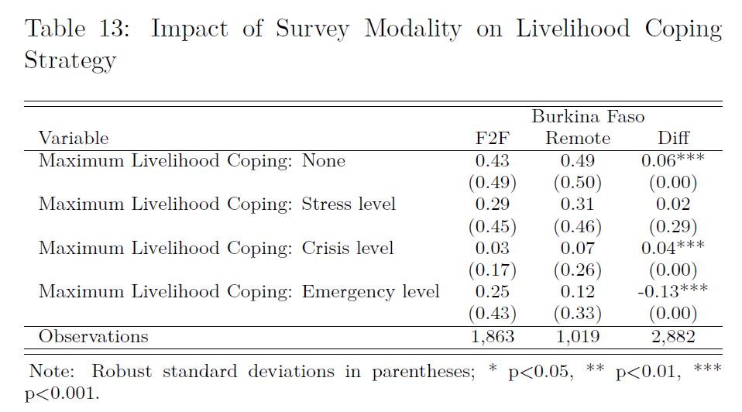
Other Food Security Outcome Indicators
Source: rCARI survey 2023
Note: Significance * p<0.10, ** p<0.05, *** p<0.01

Slide 21
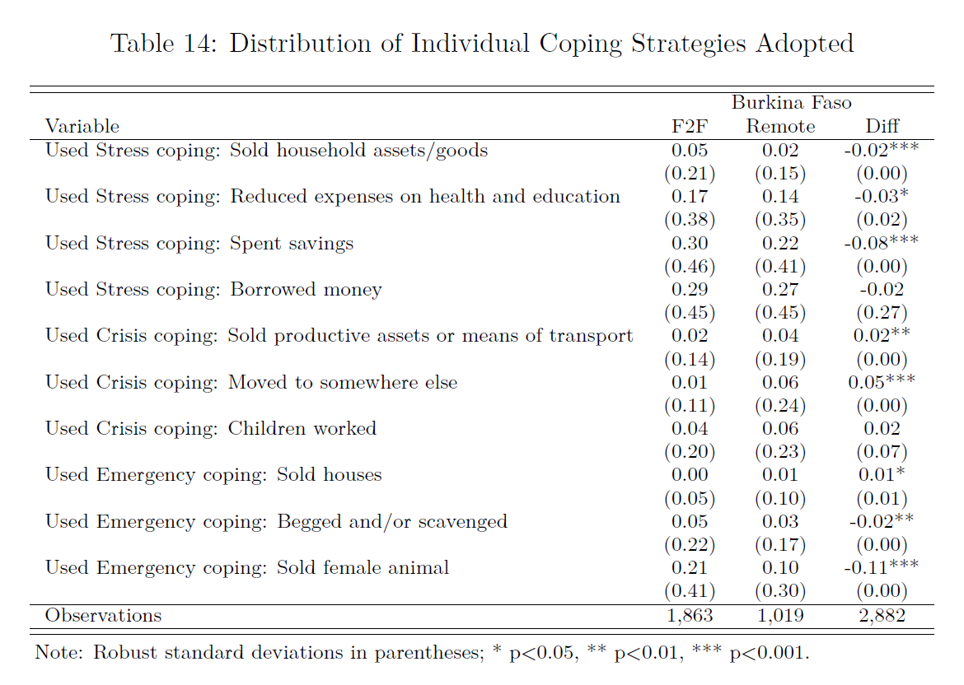
Other Food Security Outcome Indicators

Slide 22
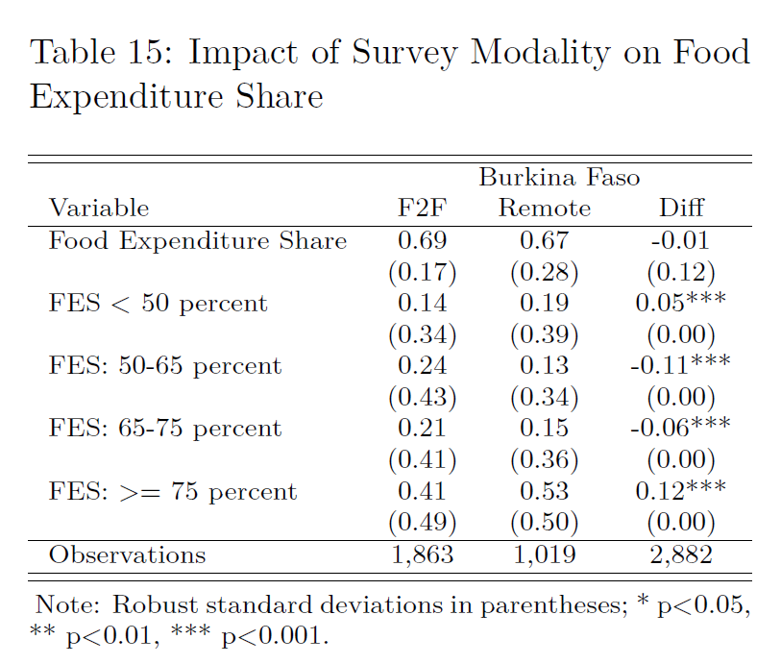
Other Food Security Outcome Indicators

Slide 23
Supplementary analysis

Slide 24
Summary and Key Points
Survey Modality:
CARI from remote surveys tend to be conservative regardless indicators used
Up to 15 p.p. compared to F2F
The difference is largely driven by the Income Source & Income Change Indicator classification
The FES indicator shows consistency across modalities (no significant difference observed)
Households in the remote arm have significantly higher and varied food consumption, and less vulnerable in terms of FES

Slide 25
Summary and Key Points
Individual FS Indicators:
Households tend to report slightly higher FCS and better livelihood coping over the phone compared to F2F
In terms of the Short- and Long-modules, results show no significant different between F2F and Remote
The shortened FES module piloted remotely tend to generally produce results comparable to the standard F2F FES module.

Slide 26
Next steps…
Conduct further in-depth analysis of the data - FES and income indicators.
Explore the actual categorization of the different income sources into the four rCARI income groups to identify trends across different pilot countries
Continue with the overall data collection in the remaining pilot countries (Iraq, Mauritania & Guatemala)

Slide 27
Comments & Questions

